Slide 1
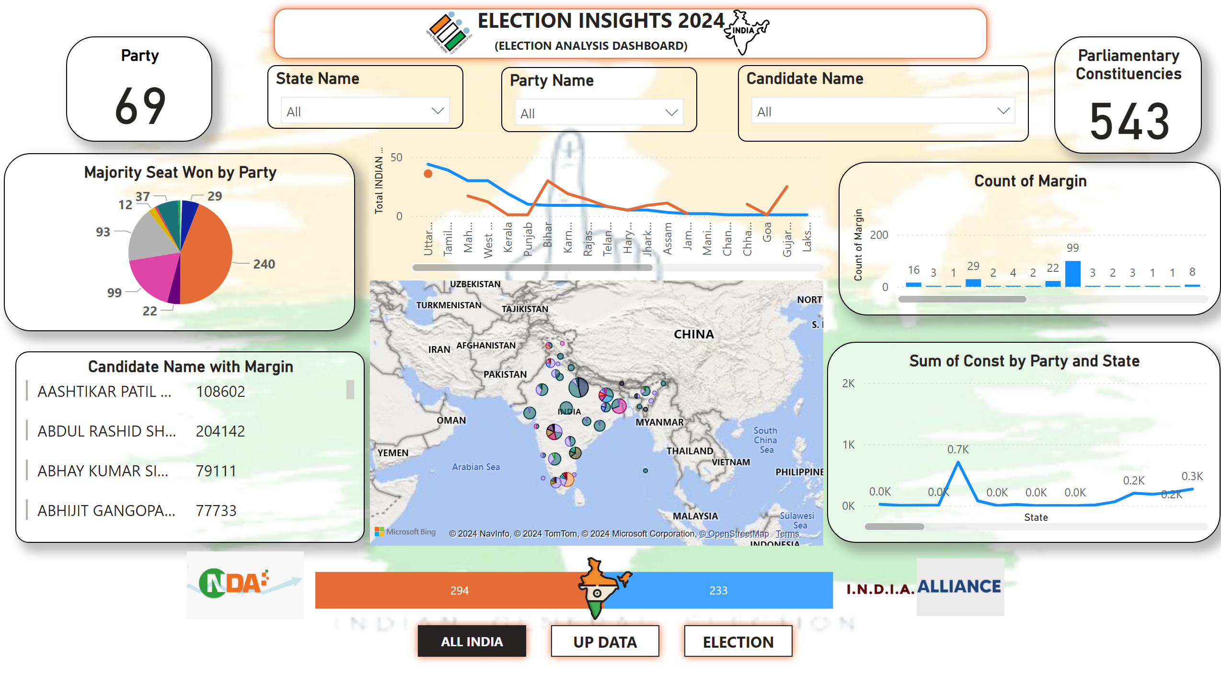
ALL INDIA
Notes:
barChart
No alt text provided
image
No alt text provided
Candidate Name with Margin
No alt text provided
Sum of Const by Party and State
No alt text provided
map
No alt text provided
Majority Seat Won by Party
No alt text provided
lineChart
No alt text provided
Count of Margin
No alt text provided
State Name
No alt text provided
Party Name
No alt text provided
Candidate Name
No alt text provided
Parliamentary Constituencies
No alt text provided
Party
No alt text provided
shape
No alt text provided
textbox
No alt text provided
image
No alt text provided
image
No alt text provided
image
No alt text provided
pageNavigator
No alt text provided
image
No alt text provided
image
No alt text provided

Slide 2
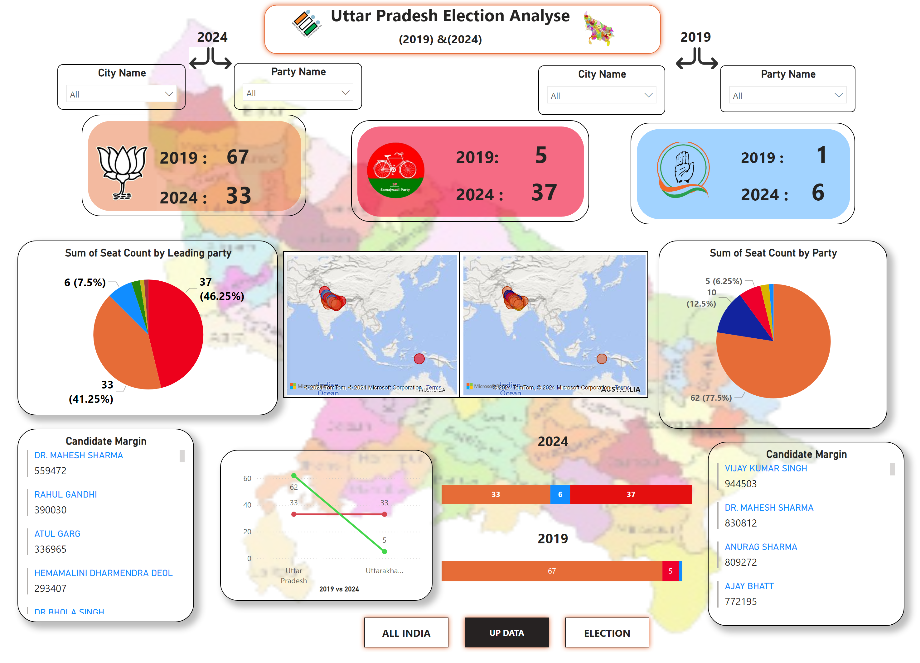
UP DATA
Notes:
map
No alt text provided
Candidate Margin
No alt text provided
pieChart
No alt text provided
shape
No alt text provided
shape
No alt text provided
shape
No alt text provided
image
No alt text provided
image
No alt text provided
image
No alt text provided
pieChart
No alt text provided
map
No alt text provided
Candidate Margin
No alt text provided
City Name
No alt text provided
Party Name
No alt text provided
City Name
No alt text provided
Party Name
No alt text provided
barChart
No alt text provided
barChart
No alt text provided
textbox
No alt text provided
textbox
No alt text provided
textbox
No alt text provided
textbox
No alt text provided
textbox
No alt text provided
textbox
No alt text provided
textbox
No alt text provided
textbox
No alt text provided
textbox
No alt text provided
textbox
No alt text provided
textbox
No alt text provided
lineChart
No alt text provided
image
No alt text provided
image
No alt text provided
shape
No alt text provided
textbox
No alt text provided
image
No alt text provided
image
No alt text provided
pageNavigator
No alt text provided

Slide 3
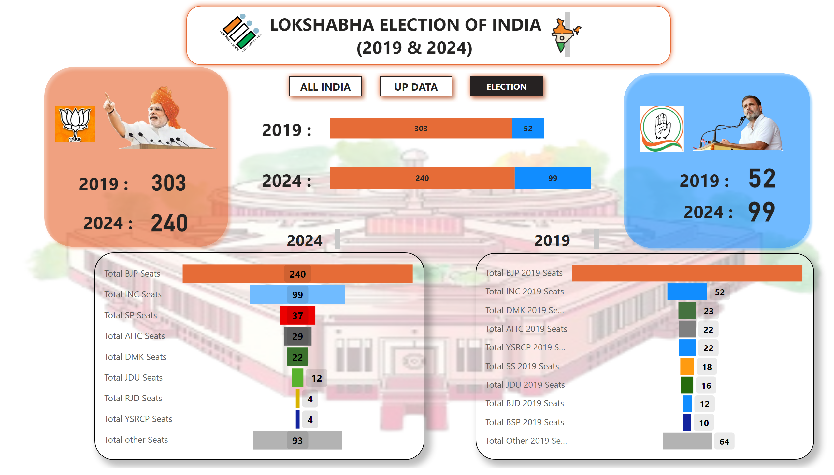
ELECTION
Notes:
funnel
No alt text provided
shape
No alt text provided
textbox
No alt text provided
shape
No alt text provided
shape
No alt text provided
image
No alt text provided
textbox
No alt text provided
textbox
No alt text provided
image
No alt text provided
image
No alt text provided
card
No alt text provided
textbox
No alt text provided
card
No alt text provided
textbox
No alt text provided
card
No alt text provided
card
No alt text provided
barChart
No alt text provided
barChart
No alt text provided
textbox
No alt text provided
textbox
No alt text provided
textbox
No alt text provided
pageNavigator
No alt text provided
image
No alt text provided
image
No alt text provided
funnel
No alt text provided
textbox
No alt text provided
image
No alt text provided

